Slide 1



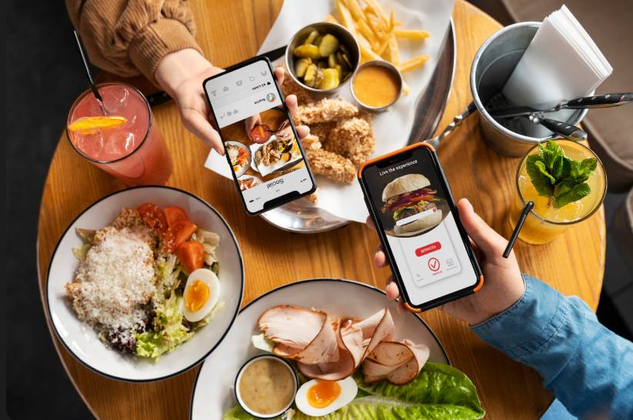
Restaurant & Consumer Data Analysis
PRESENTED BY:
T.YAMINI
CH.HEMADIVYA
G.SUPRIYA

Slide 2


ABOUT US
T.YAMINI
B.TECH-ECE/DATA ANALYTICS
LINKEDIN: https://www.linkedin.com/in/yamini-prasanna-tibirisetty-ba1436393/
GITHUB: https://github.com/Yaminiprasanna143
CH.HEMADIVYA
B.TECH-ECE/DATA ANALYTICS
LINKEDIN: https://www.linkedin.com/in/chappidi-hema-divya-396427295
GITHUB: https://github.com/hemachappidi23
G.SUPRIYA
B.TECH-CSE/DATA ANALYTICS
LINKEDIN: www.linkedin.com/in/gajawada-supriya-2010752ab GITHUB: https://github.com/supriyagajawada123

Slide 3

AGENDA
Introduction to the Restaurant & Consumer Dataset
Understanding database tables and their relationships
Data exploration using SQL queries
Filtering data using WHERE clause
Analyzing data using JOINs and subqueries
Applying aggregation, grouping, and conditional logic
Using advanced SQL concepts (CTEs, Views, Window Functions, Stored Procedures)
Extracting key insights from ratings and consumer behavior
Conclusion and learning outcomes

Slide 4





INTRODUCTION
Data plays a crucial role in understanding customer behavior and improving business decisions.
This project focuses on analyzing a real-world dataset to uncover meaningful patterns, trends, and insights.
The goal of this analysis is to support better decision-making, identify key factors affecting performance, and highlight areas for improvement.
This presentation summarizes the dataset overview, analysis approach, key findings, and insights in a simple and understandable way.

Slide 5

PROJECT OVERVIEW
This project focuses on analyzing a real-world Restaurant & Consumer dataset using SQL. The dataset consists of multiple related tables such as Restaurants, Consumers, Ratings, Restaurant Cuisines, and Consumer Preferences.
The analysis involves writing SQL queries ranging from basic filtering to advanced concepts like CTEs, derived tables, window functions, views, and stored procedures. Through this approach, the project aims to uncover patterns in consumer behavior, restaurant performance, cuisine popularity, and rating trends.
The project demonstrates how SQL can be effectively used to transform raw data into meaningful insights that can help businesses improve customer satisfaction, optimize services, and make informed decisions.

Slide 6


PROBLEM STATEMENT
Restaurants generate large amounts of data related to consumers, ratings, cuisines, and preferences, but this data is often underutilized. Without proper analysis, it becomes difficult to understand customer behavior, evaluate restaurant performance, and identify factors influencing customer satisfaction.
The problem is to analyze the Restaurant & Consumer dataset using SQL to extract meaningful insights that help understand consumer demographics, preferences, restaurant characteristics, and rating patterns, thereby supporting better data-driven decision making.

Slide 7

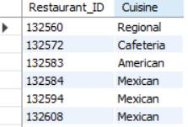
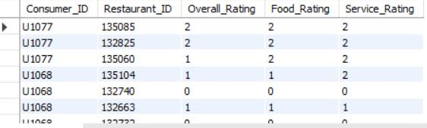
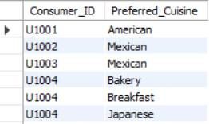
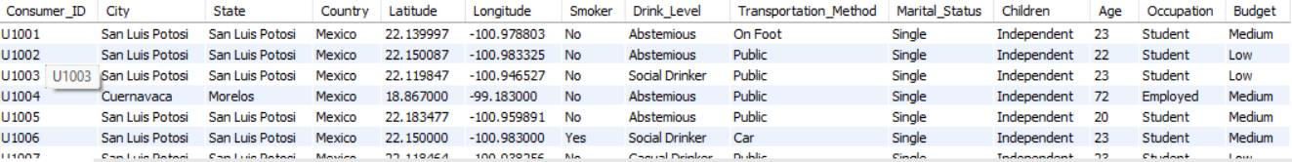
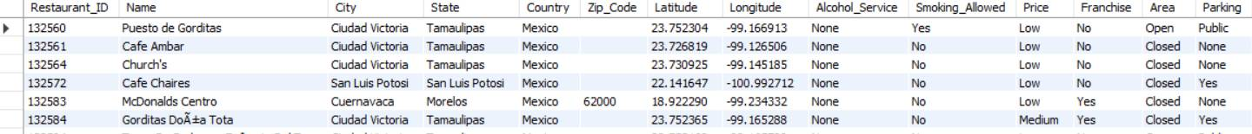

TABLES
Resturants
Restaurant_cuisines
Consumer_Preferences
Consumers
Ratings

Slide 8

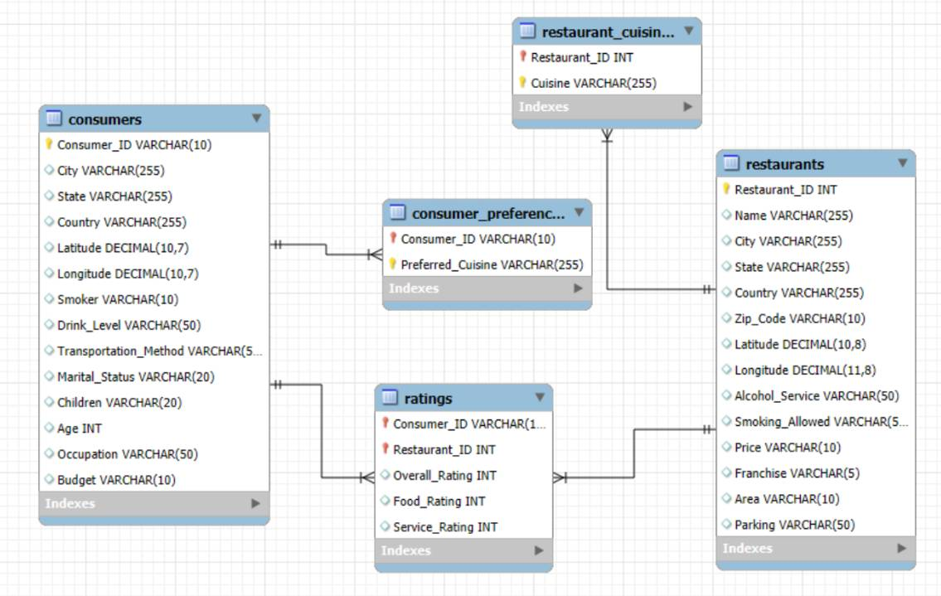

ER DIAGRAMS

Slide 9
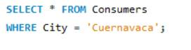
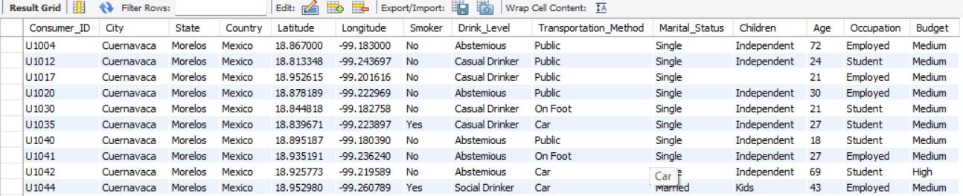


Using WHERE clause to fliter data based on specific criteria
1.List all details of consumers who live in the city of 'Cuernavaca'.

Slide 10

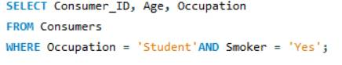

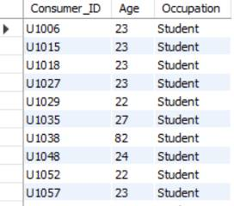
2.Find the Consumer_ID, Age, and Occupation of all consumers who are 'Students' AND are 'Smokers'.

Slide 11

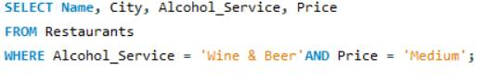
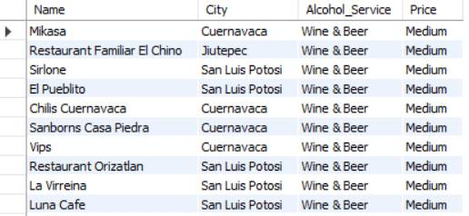
3.List the Name, City, Alcohol_Service, and Price of all restaurants that serve 'Wine & Beer' and have a 'Medium' price level.

Slide 12

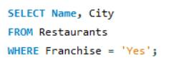

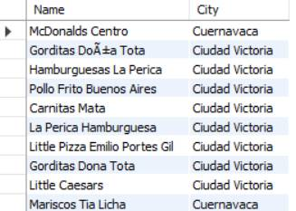
4.Find the names and cities of all restaurants that are part of a 'Franchise'.

Slide 13
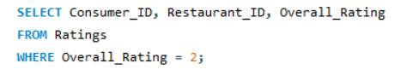
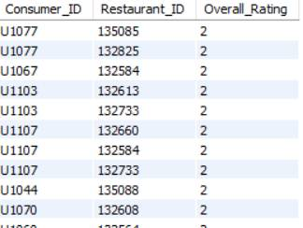

5.Show the Consumer_ID, Restaurant_ID, and Overall_Rating for all ratings where the Overall_Rating was 'Highly Satisfactory' (which corresponds to a value of 2, according to the data dictionary).

Slide 14


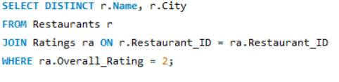
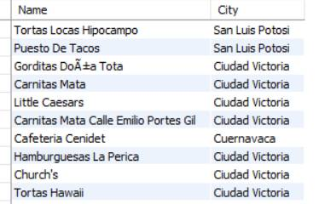

Questions JOINs with Subqueries
1.List the names and cities of all restaurants that have an Overall_Rating of 2 (Highly Satisfactory) from at least one consumer.

Slide 15
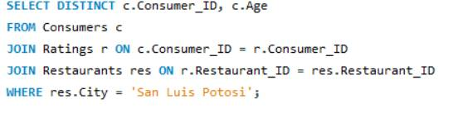


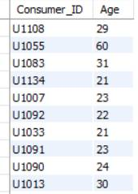
2.Find the Consumer_ID and Age of consumers who have rated restaurants located in
'San Luis Potosi'.

Slide 16
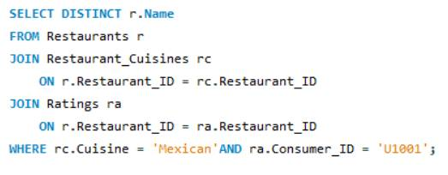

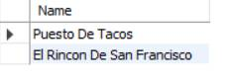
3.List the names of restaurants that serve 'Mexican' cuisine and have been rated by consumer 'U1001'.

Slide 17


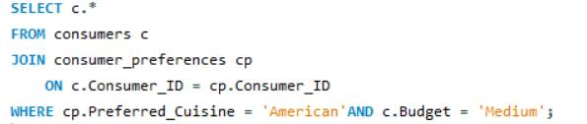
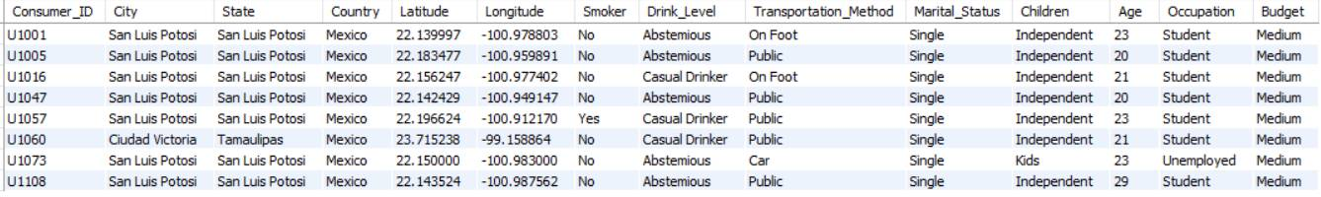
4.Find all details of consumers who prefer 'American' cuisine AND have a 'Medium' budget.

Slide 18

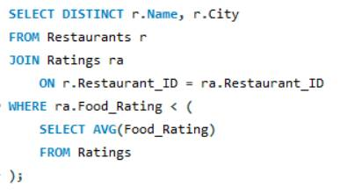
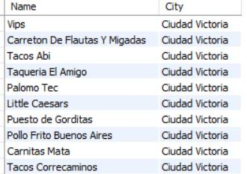
5.List restaurants (Name, City) that have received a Food_Rating lower than the average Food_Rating across all rated restaurants.

Slide 19
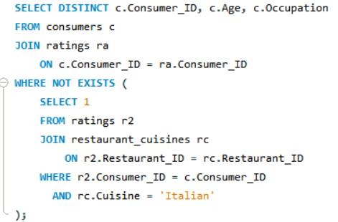
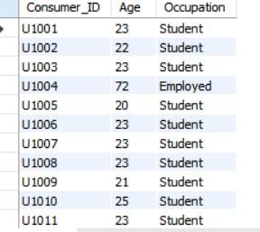

6. Find consumers (Consumer_ID, Age, Occupation) who have rated at least one restaurant but have NOT rated any restaurant that serves 'Italian' cuisine.

Slide 20
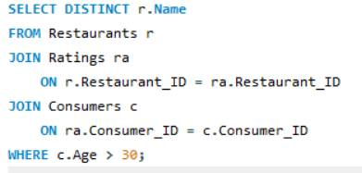
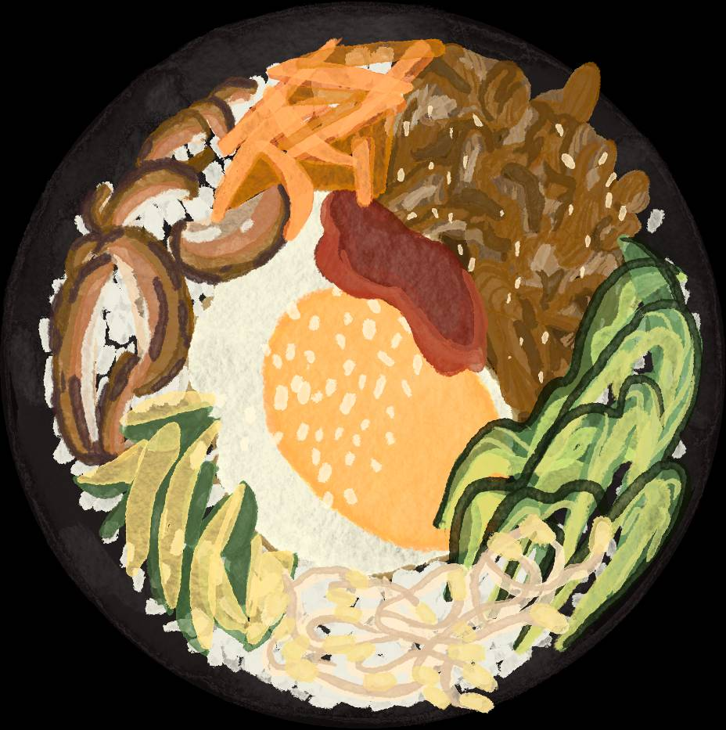
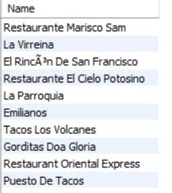

7.List restaurants (Name) that have received ratings from consumers older than 30.

Slide 21

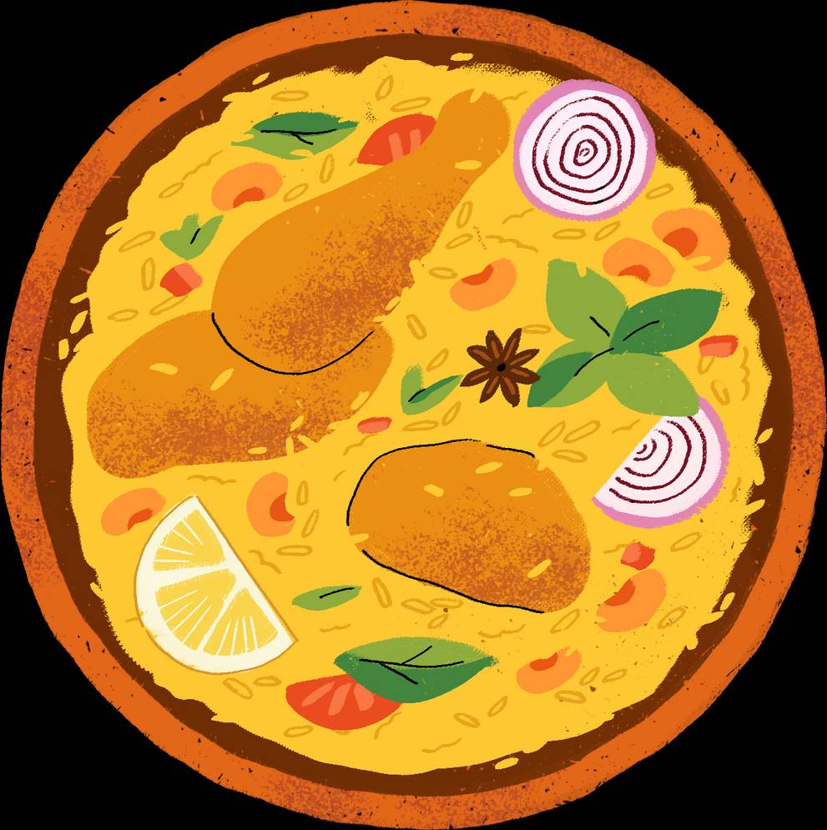
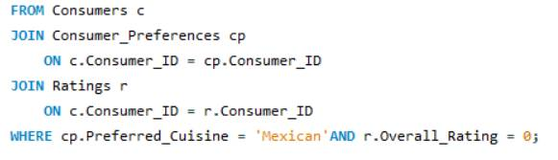
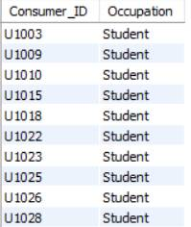
8.Find the Consumer_ID and Occupation of consumers whose preferred cuisine is 'Mexican' and who have given an Overall_Rating of 0 to at least one restaurant (any restaurant)

Slide 22


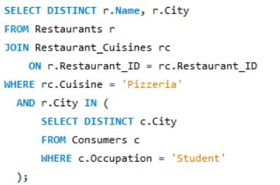


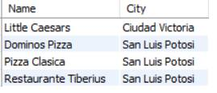

9.List the names and cities of restaurants that serve 'Pizzeria' cuisine and are located in a city where at least one 'Student' consumer lives.

Slide 23
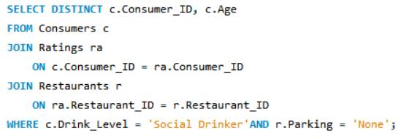
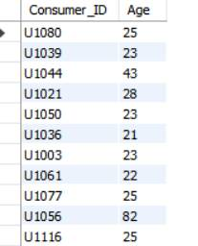
10. Find consumers (Consumer_ID, Age) who are 'Social Drinkers' and have rated a restaurant that has 'No' parking.

Slide 24

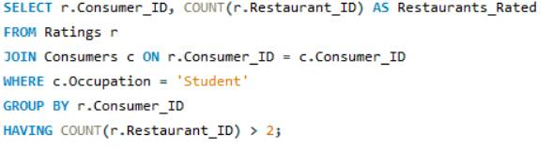
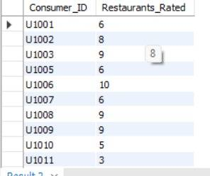

Questions Emphasizing WHERE Clause and Order of Execution
1.List Consumer_IDs and the count of restaurants they've rated, but only for consumers who are 'Students'. Show only students who have rated more than 2 restaurants.

Slide 25
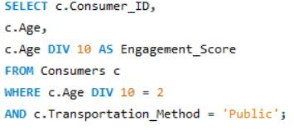

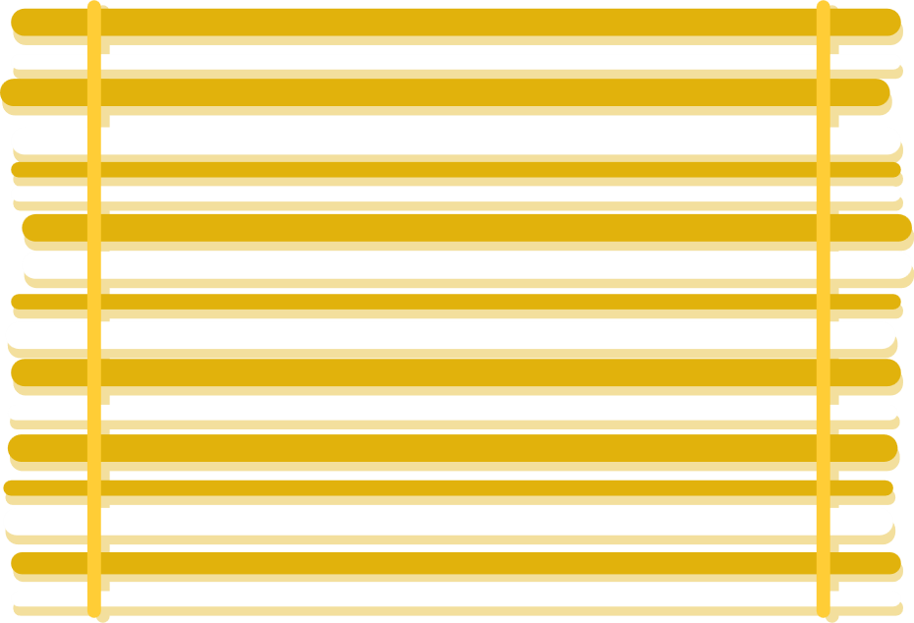
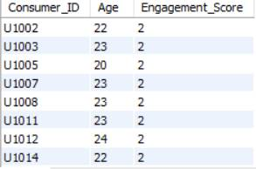
2.We want to categorize consumers by an 'Engagement_Score' which is their Age divided by 10 (integer division). List the Consumer_ID, Age, and this calculated Engagement_Score, but only for consumers whose Engagement_Score would be exactly 2 and who use 'Public' transportation

Slide 26

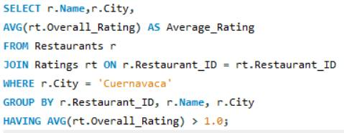

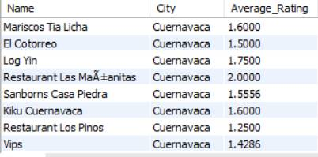
3.For each restaurant, calculate its average Overall_Rating. Then, list the restaurant Name, City, and its calculated average Overall_Rating, but only for restaurants located in 'Cuernavaca' AND whose calculated average Overall_Rating is greater than 1.0.

Slide 27
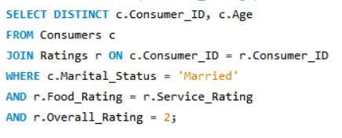
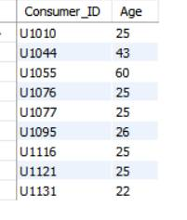
4. Find consumers (Consumer_ID, Age) who are 'Married' and whose Food_Rating for any restaurant is equal to their Service_Rating for that same restaurant, but only consider ratings where the Overall_Rating was 2.

Slide 28
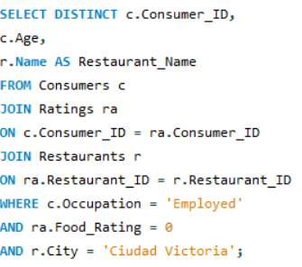

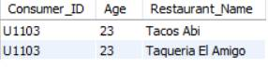

5.List Consumer_ID, Age, and the Name of any restaurant they rated, but only for consumers who are 'Employed' and have given a Food_Rating of 0 to at least one restaurant located in 'Ciudad Victoria'.

Slide 29


Advanced SQL Concepts: Derived Tables, CTEs, Window Functions, Views, Stored Procedures
1.For each Occupation, find the average age of consumers. Only consider consumers who have made at least one rating. (Use a derived table to get consumers who have rated)

Slide 30




2.Using a CTE to get all ratings for restaurants in 'Cuernavaca', rank these ratings within each restaurant based on Overall_Rating (highest first). Display Restaurant_ID, Consumer_ID, Overall_Rating, and the RatingRank.

Slide 31




3.For each rating, show the Consumer_ID, Restaurant_ID, Overall_Rating, and also display the average Overall_Rating given by that specific consumer across all their ratings.

Slide 32


4.Consider all ratings made by 'Consumer_ID' = 'U1008'. For each rating, show the Restaurant_ID, Overall_Rating, and the Overall_Rating of the next restaurant they rated (if any), ordered by Restaurant_ID (as a proxy for timing rating time isn't available). Use a derived table to filter for the consumer's ratings first.

Slide 33



7. Create a VIEW named Highly Rated Mexican Restaurants that shows the Restaurant_ID, Name, and City of all Mexican restaurants that have an average Overall_Rating greater than 1.5.

Slide 34



8. First, ensure the HighlyRatedMexicanRestaurants view from Q7 exists. Then, using a CTE to find consumers who prefer 'Mexican' cuisine, list those consumers (Consumer_ID) who have not rated any restaurant listed in the HighlyRatedMexicanRestaurants view.

Slide 35


10. Identify the top 2 highest-rated (by Overall_Rating) restaurants for each cuisine type. If there are ties in rating, include all tied restaurants. Display Cuisine, Restaurant_Name, City, and Overall_Rating.

Slide 36


CONCLUSION
This project successfully demonstrated how SQL can be used to analyze real-world Restaurant & Consumer data and transform raw information into meaningful insights. By working with multiple related tables such as consumers, restaurants, ratings, cuisines, and preferences, we explored customer behavior, restaurant performance, and rating patterns in depth.
Using basic to advanced SQL concepts—including WHERE clauses, JOINs, subqueries, aggregations, CTEs, views, window functions, and stored procedures—we were able to answer complex business questions efficiently. The analysis helped identify popular cuisines, highly rated restaurants, consumer demographics, and factors influencing customer satisfaction.
Overall, this project strengthened our understanding of relational databases and SQL querying techniques, while highlighting the importance of data-driven decision making in the restaurant industry. The insights derived from this analysis can help businesses improve service quality, target the right customers, and enhance overall customer experience.

Slide 37




THANK YOU
For Attention

